Slide 1
Evaluation Metrics

Slide 2
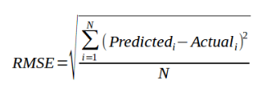
Evaluating Regression Models:
RMSE, RSE, MAE, RAE
RMSE:
RMSE is a popular formula to measure the error rate of regression model.
However it can only be compared between the models whose error rates are measured in same units.

Slide 3
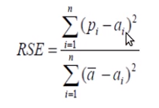
Relative Squared Error (RSE).
Can be compared the models whose errors are measured in different units.

Slide 4
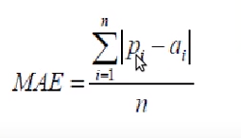
Mean Absolute Error(MAE):
Similar in magnitude to RMSE, But slightly smaller than RMSE.
MAE has same unit as original data , it can only be compared between models whose errors are measured in the same units.

Slide 5
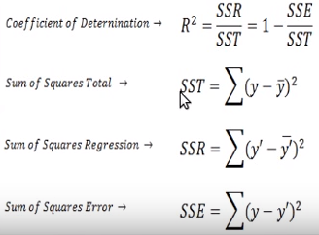
Coefficient of Determination.
It summarize the explanatory power of regression model and is computed from sum-of-square terms.
R^2 is described the proportion of variance of dependent variable explained by regression model.
If the regression model “Perfect” , SSE is Zero, and R^2 is 1.
If the model is total failure , SSE is Equal to SST, no variance is explained by regression.

Slide 6
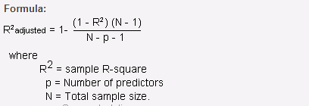
Adjusted R^2
Adjusted R squared is a corrected goodness-of-fit (model accuracy) measure for linear models.
It identifies the percentage of variance in the target field that is explained by the input or inputs.
Adjusted R squared is calculated by dividing the residual mean square error by the total mean square error (which is the sample variance of the target field). The result is then subtracted from 1.
Adjusted R² is always less than or equal to R².

Slide 7
        Thank You.

